Slide 1
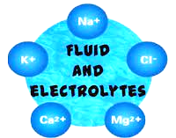
Fundamentals of Nursing II (1st Stage)
Second Semester
Lecture 2: Theory
Fluid and electrolyte & Blood transfusion

Slide 2
1- Body Fluids
The term total body water or fluid refers to the total amount of water which is approximately 50% to 60% of body weight in a healthy person.
University of Basrah –College of Nursing– Fundamentals of Nursing Department

Slide 3
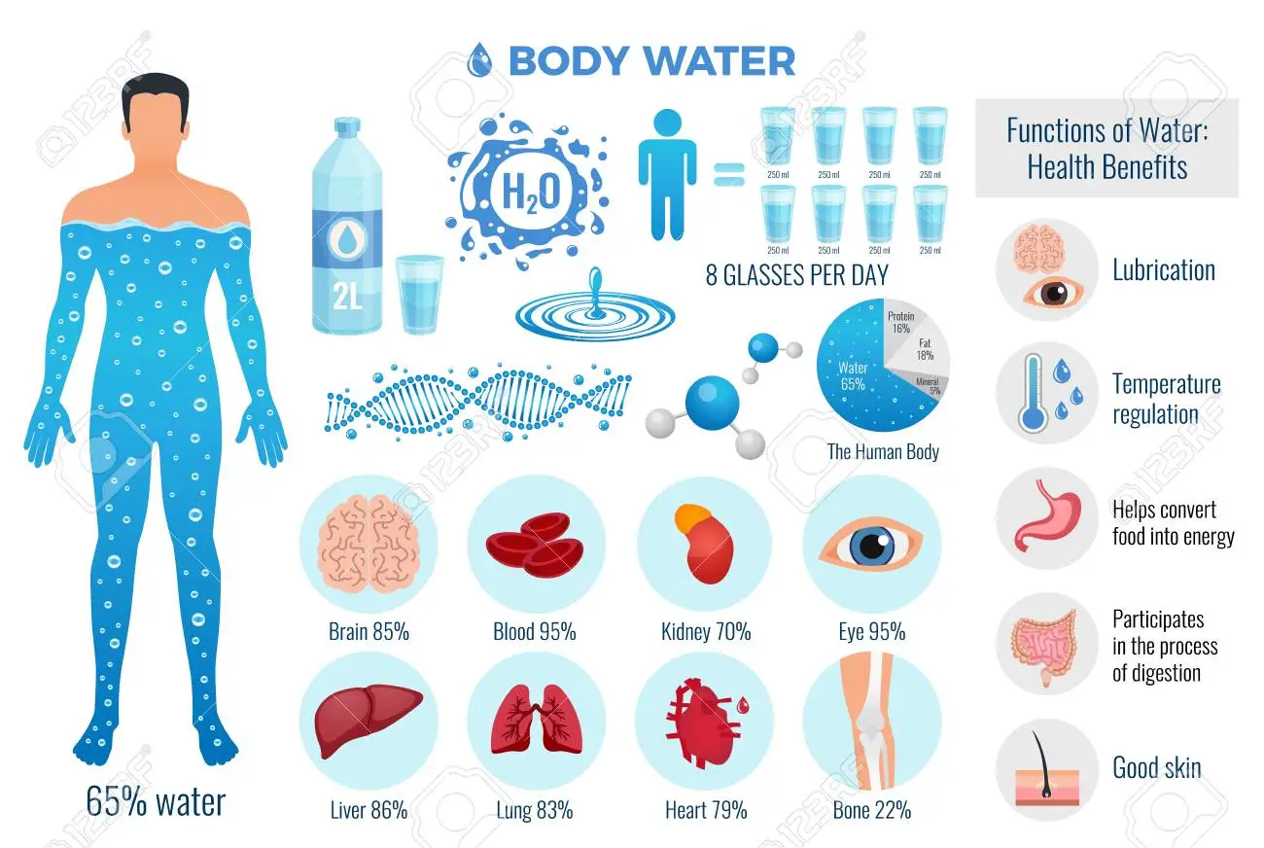
Essential Function of Water:
Transport nutrients to cells and wastes from cells
Transport hormones, enzymes, blood platelets, red and white blood cells.
Facilitate cellular metabolism.
Help maintain normal body temperature
Facilitate digestion and promote elimination
Tissue lubricant
University of Basrah –College of Nursing– Fundamentals of Nursing Department

Slide 5
Variations in Fluid Content
Variations in the fluid content from the normal 50% to 60% of the body’s weight can occur, depending on such factors as the person’s age, body fat, and gender.
Age: Infants more total body fluid and ECF than adults.
Gender & Fat: Fat cells contain little water, whereas lean tissue is rich in water.
In addition, older adults lose muscle mass as a part of aging. The combined increase of fat and loss of muscle results in reduced total body water; after the age of 60, total body water is about 45% of a person’s body weight.
University of Basrah –College of Nursing– Fundamentals of Nursing Department

Slide 6
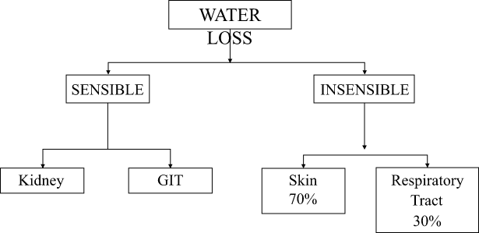
.
Fluid Loss
1- Sensible losses: can be measured and include fluid lost during urination, defecation, and wounds.
2- Insensible losses: cannot be measured or seen and include fluid lost from evaporation through the skin and as water vapor from the lungs during respiration.

Slide 8
Fluid Imbalances
1- Fluid Volume Deficit(FVD)
Is caused by a loss of both water and solutes in the same proportion from the ECF space. This state is commonly known as hypovolemia or isotonic fluid loss.
Young children, older adults, and people who are ill are especially at risk for hypovolemia.
Fluid volume deficit can rapidly result in a weight loss of 5% in adults and 10% in infants.
A 5% weight loss is considered a pronounced fluid deficit; an 8% loss or more is considered severe. A 15% weight loss caused by fluid deficiency usually is life threatening.
University of Basrah –College of Nursing– Fundamentals of Nursing Department

Slide 9
2- Fluid Volume Excess (FVE)
retention of water and sodium in ECF in near equal proportions results in a condition termed fluid volume excess. It is also called hypervolemia or excess of isotonic fluid.
Common causes include:
1- Renal Failure.
2- Heart Failure.
Accumulation of fluid may result
in a weight gain in excess of 5%.
University of Basrah –College of Nursing– Fundamentals of Nursing Department

Slide 10
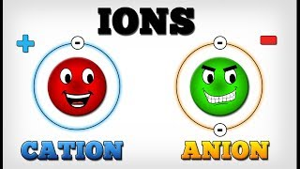
2- Electrolytes
Electrolyte is body fluid are active chemicals.
cations: positive charge
The major cations in body fluid are sodium, potassium, calcium, hydrogen, and magnesium ions.
Anions: negative charge
The major anions in body fluid are chloride, bicarbonate, and phosphate.
Molecules in the body that remain intact, without a charge, are called nonelectrolytes. In the human body, urea and glucose are examples of nonelectrolytes.

Slide 11
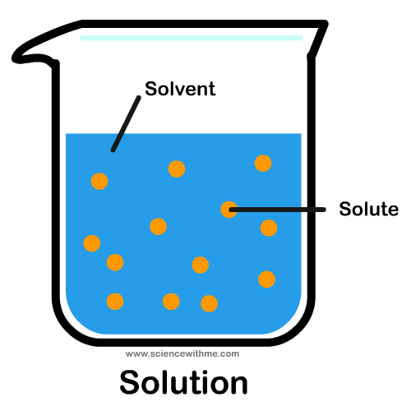
Fluid and Electrolyte Balance
The body produces balance by shifting fluids and solutes between the ECF and the ICF.
** Solvents are liquids that hold a substance in
solution (water).
** solutes are substances that are dissolved in
a solution (electrolytes and nonelectrolytes).
University of Basrah –College of Nursing– Fundamentals of Nursing Department

Slide 12
Fluid and Electrolyte Balance
The mechanisms responsible for regulating this shift of fluids and transporting materials to and from intracellular compartments include:
1- Organs and body systems.
2- Osmosis.
3- Diffusion.
4- Active transport.
5-Capillary filtration.
University of Basrah –College of Nursing– Fundamentals of Nursing Department

Slide 13
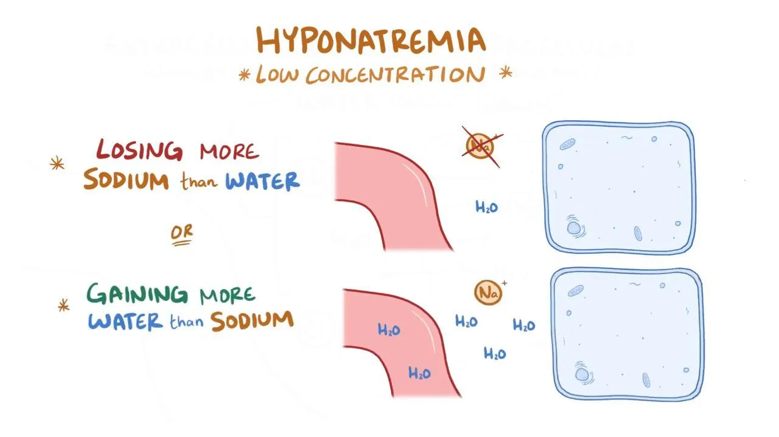
Electrolyte Imbalances
1- Hyponatremia and Hypernatremia
Hyponatremia: refers to a sodium deficit in ECF (serum sodium <135 mEq/L) caused by a loss of sodium or a gain of water.
confusion.
hypotension, edema.
muscle cramps and weakness.
dry skin.
Cerebral edema can lead to seizures.
Permanent neurologic damage and death can result from severe hyponatremia.
Na+

Slide 14
Electrolyte Imbalances
Hypernatremia: Rise in serum sodium concentration >145 mmol/L.
Caused by excess water loss or an overall excess of sodium.
Affect on the cells of the central nervous system, resulting in signs of neurologic impairment, including restlessness,
weakness, disorientation, delusion.
Na+

Slide 15
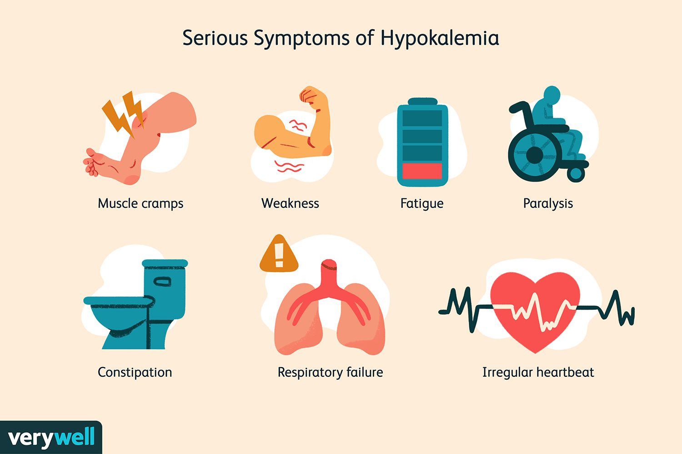
2- Hypokalemia and Hyperkalemia
Hypokalemia: refers to a potassium deficit in ECF (serum potassium <3.5 mEq/L). Potassium may be lost through vomiting, gastric suction, alkalosis, diarrhea, or as the result of the use of diuretics.
Typical signs of hypokalemia include:
muscle weakness and leg cramps.
Fatigue.
Paresthesia.
dysrhythmias.
K+
University of Basrah –College of Nursing– Fundamentals of Nursing Department

Slide 16
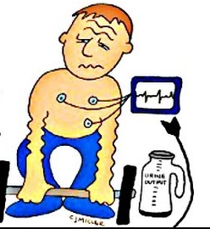
2- Hypokalemia and Hyperkalemia
Hyperkalemia refers to an excess of potassium in ECF (serum potassium >5 mEq/L).
Excess potassium may result from renal failure, or the use of certain medications.
Hyperkalemia result in:
Nerve and muscle contractility problems.
Skeletal muscle weakness and paralysis.
cardiac irregularities may lead to cardiac arrest.
K+

Slide 17
3- Hypocalcemia and Hypercalcemia
Hypocalcemia: refers to a calcium deficit in ECF (serum calcium <8.9 mg/dL, ionized calcium <4.5 mg/dL).
Common causes: inadequate calcium intake, impaired calcium absorption. and excessive calcium loss.
Manifestations of hypocalcemia include:
Numbness and tingling of fingers, mouth, or feet.
Muscle cramps.
Seizures.
Ca

Slide 18
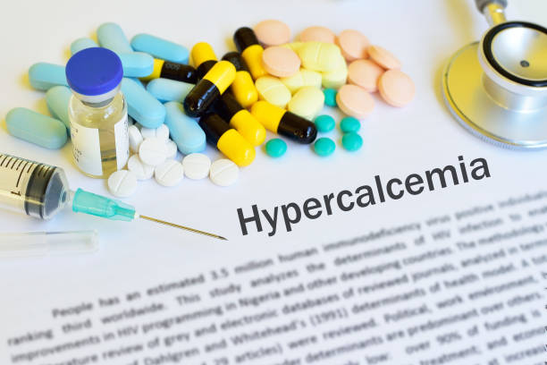
Hypercalcemia: refers to an excess of calcium in ECF (serum calcium >10.1 mg/dL).
Two major causes of hypercalcemia are cancer and hyperparathyroidism.
Manifestations of hypercalcemia include:
Nausea.
Vomiting.
Constipation.
Bone pain.
(serum calcium ≥17 mg/dL) is an emergency
situation because cardiac arrest may result.
Ca

Slide 19
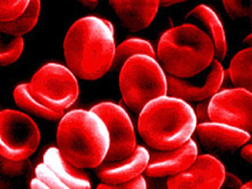
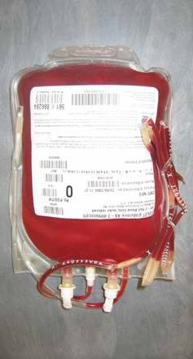
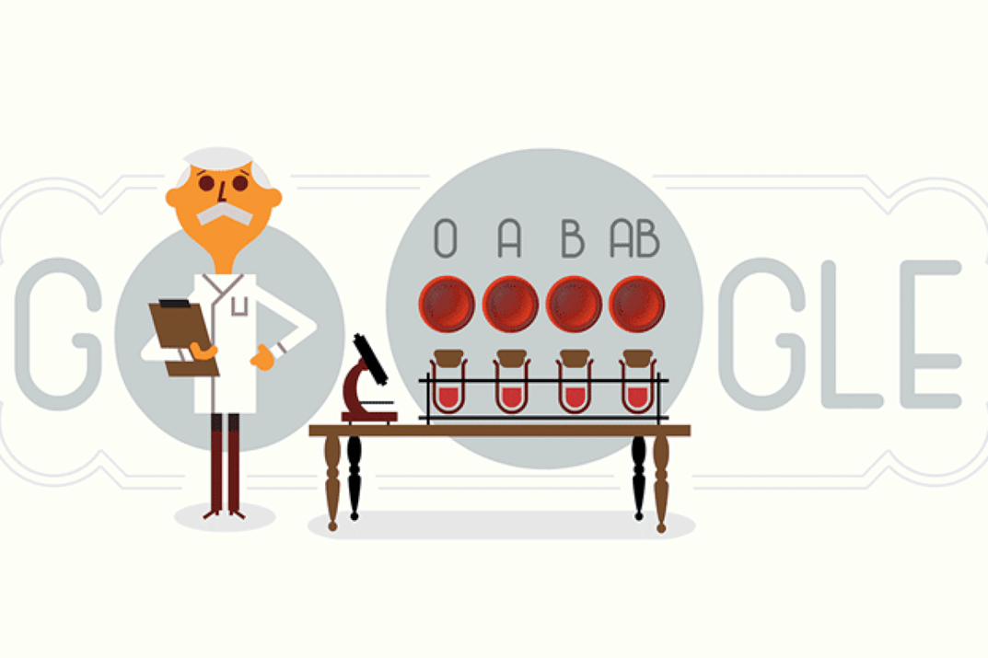
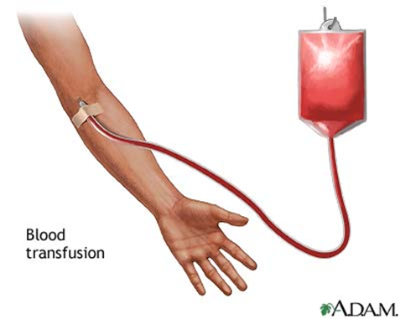
Part II - Blood transfusion

Slide 20
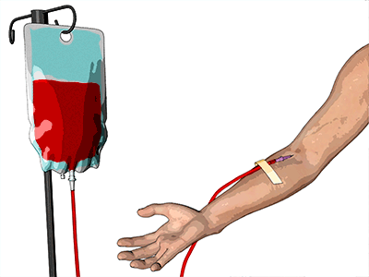
What is blood transfusion
▪The transfer of blood or blood components from one person (the donor) into the bloodstream of another person (the recipient)

Slide 21
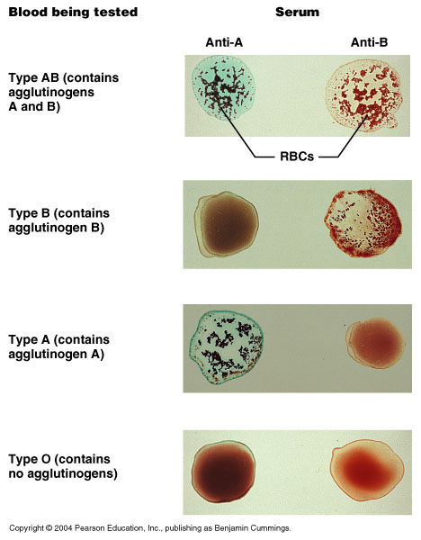
Blood Typing

Slide 22
Cross Matching
▪Cross Matching is a procedure performed prior to a blood transfusion to detect incompatibilities between the donor and recipient.

Slide 23
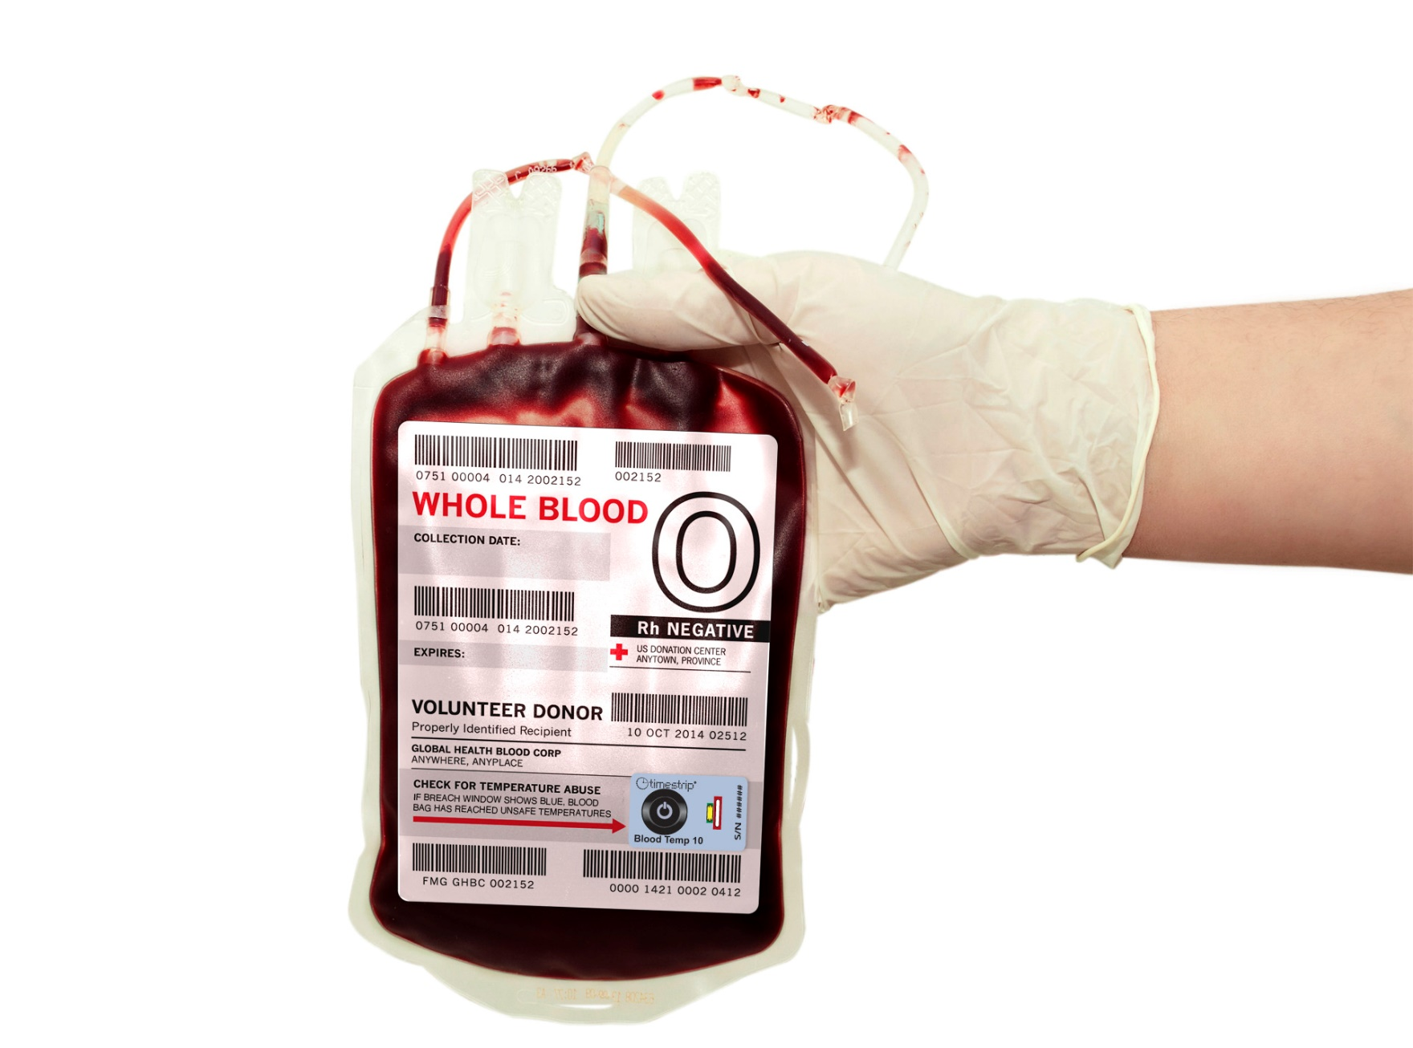
Blood Donation : Who Can Give Blood?
Basic Eligibility Guidelines
Age:
Weight:
Hb:
Serum Transmitted Disease patient :
Vaccintion:
High Blood Pressure:
Diabetes:
Cold and Flu:
Diet:
Tattoos and Piercing:

Slide 24
Storage of blood
Blood should be tested for Blood/Serum Transmitted Diseases (STDs) before storage

Slide 25
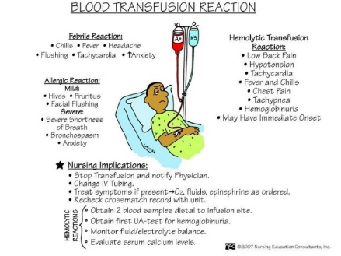
Hazards of blood transfusion
Transfusion reaction
Due to mismatching/hemolytic
(Agglutination/Immunologic reaction)
Other than mismatching

Slide 26
Hemolytic Transfusion Reactions (HTR)

Slide 27
Non-Hemolytic Transfusion Reactions (NHTR)
Mild Allergic Reactions
Anaphylactic Shock
Spread of Serum Transmitted Disease
& Non hemolytic

Slide 28
Transfusion of Blood Components
Transfusion of ‘Blood Components’ is –
When, specific portion or fraction of blood that is lacking in a patient is transfused.
Advantages of blood component therapy
Avoids the risk of sensitizing the patients to other blood components.
Provides optimal therapeutic benefit while reducing risk of volume overload.
Increases availability of needed blood products to larger population.
Thus it is a safe and low risk procedure

Slide 29
University of Basrah –College of Nursing– Fundamentals of Nursing Department

